Slide 1


Building and analyzing networks with Cytoscape and PSICQUIC

Slide 2
Workflow
Obtain protein-protein interactions
PSICQUIC-based interaction import client in Cytoscape
Visualize network
Cytoscape
Basic network analysis
Filtering your network based on columns
Cytoscape: Using filters
Integrate quantitative proteomics information in the network
Cytoscape: Load columns
Identify heavily connected sub-networks
Cytoscape: clusterMaker2 app
Analyze meaningful GO annotation
Cytoscape: BiNGO app

Slide 3
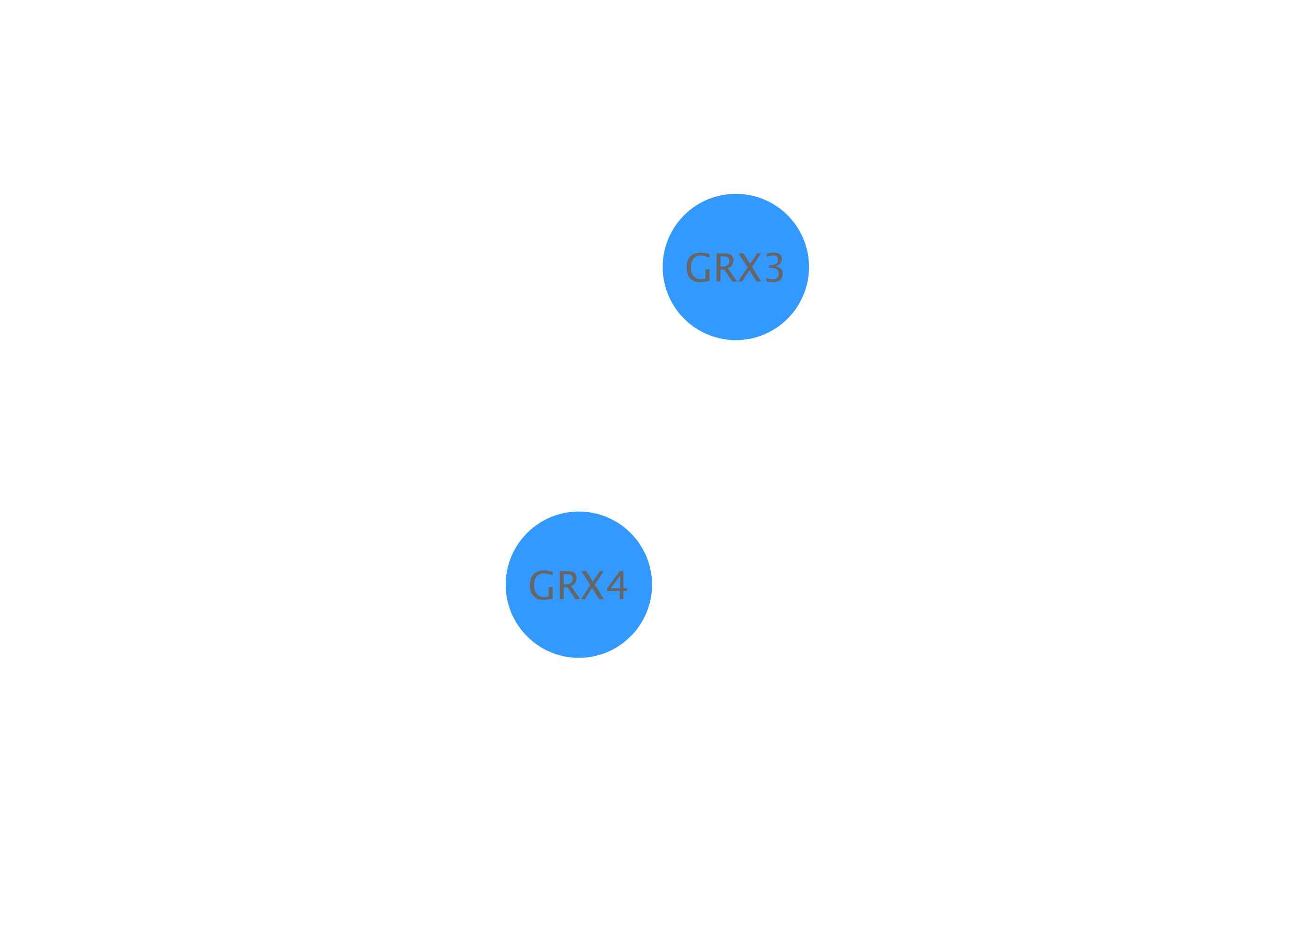
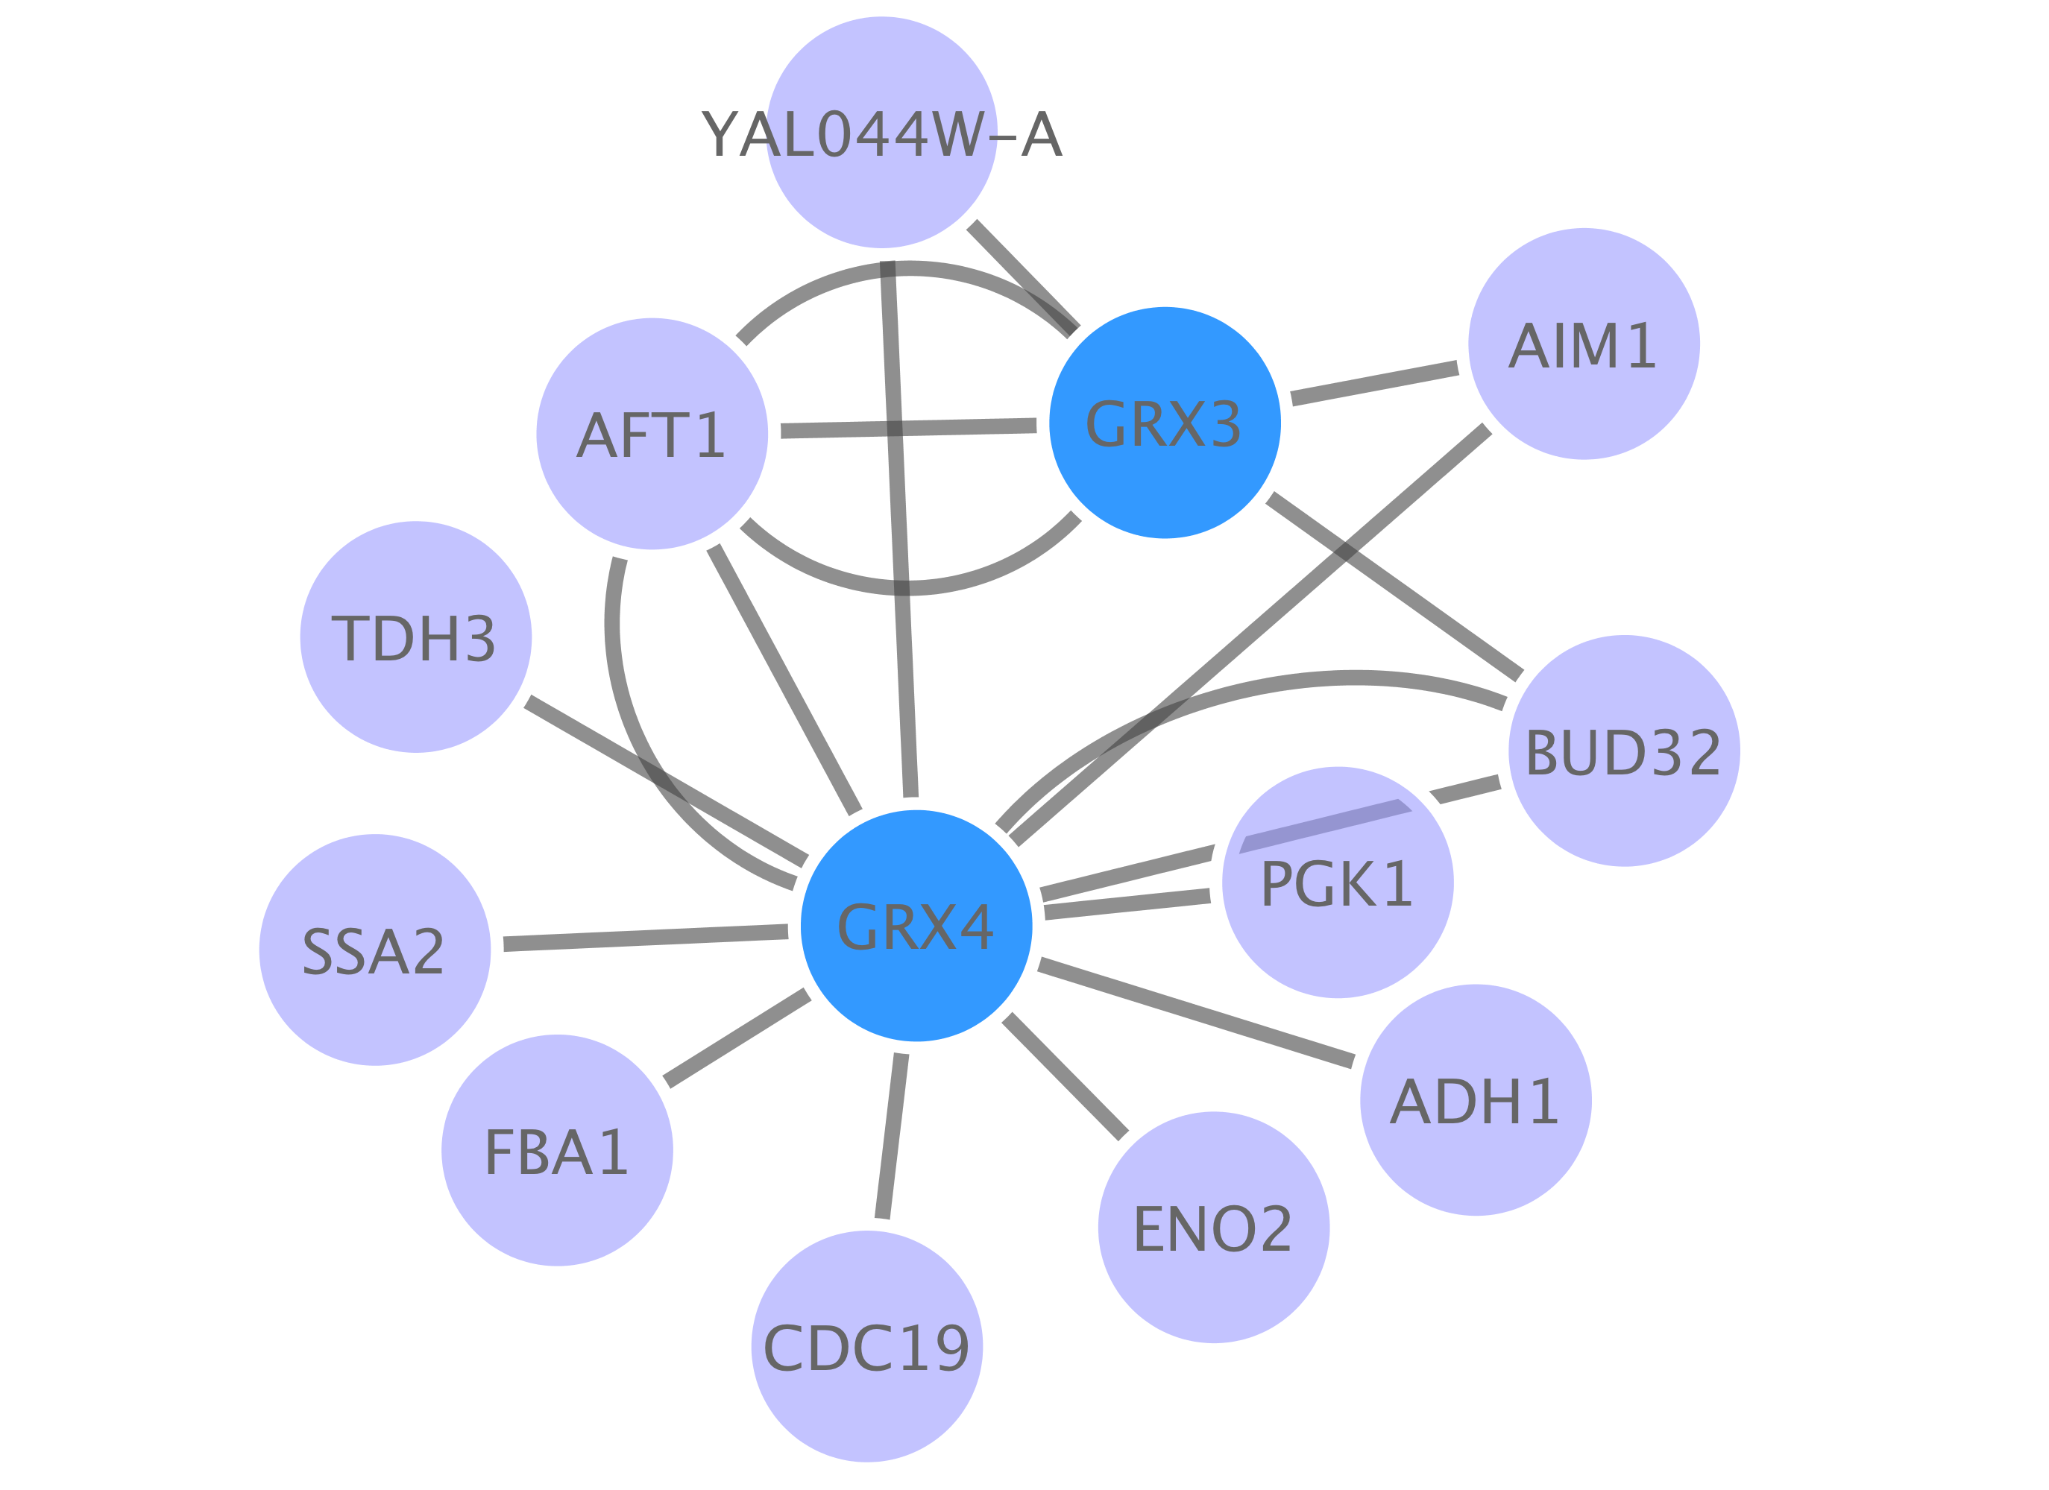
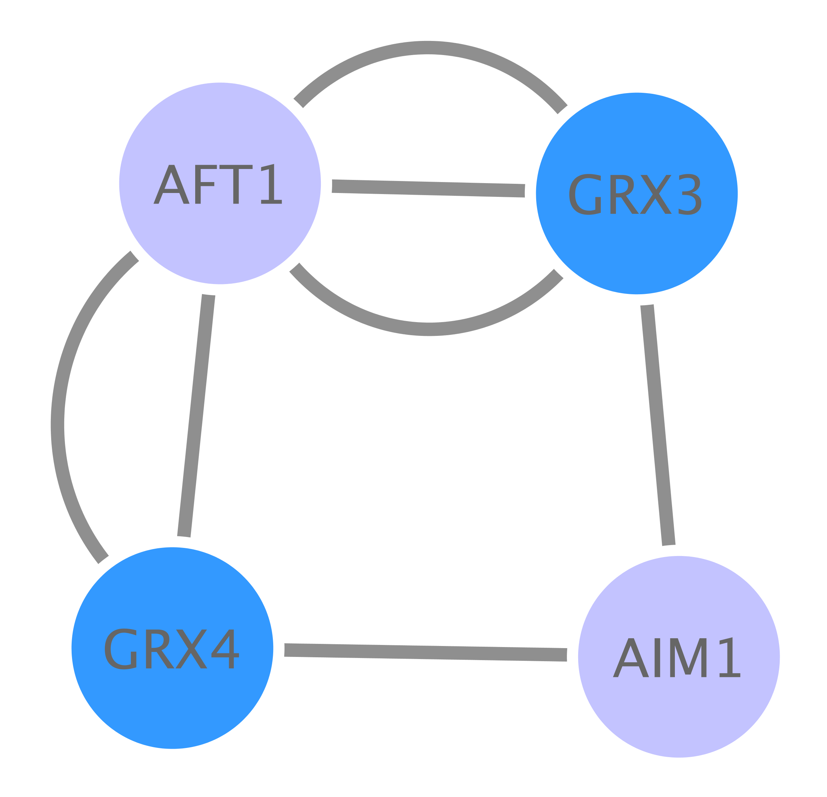
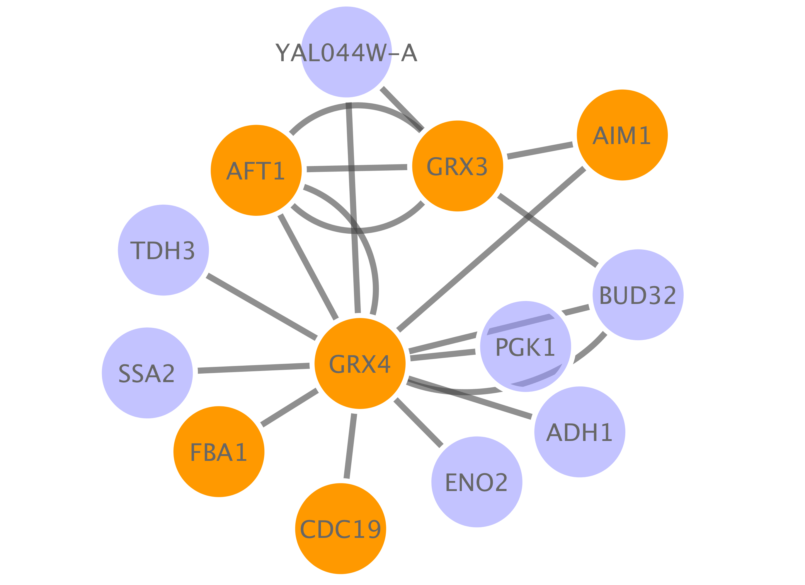
Workflow
Base PPI network
List of proteins (seed)
Topological clustering
Annotation enrichment

Slide 4
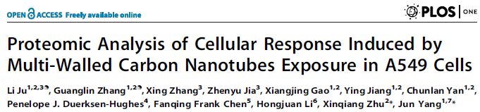
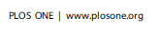
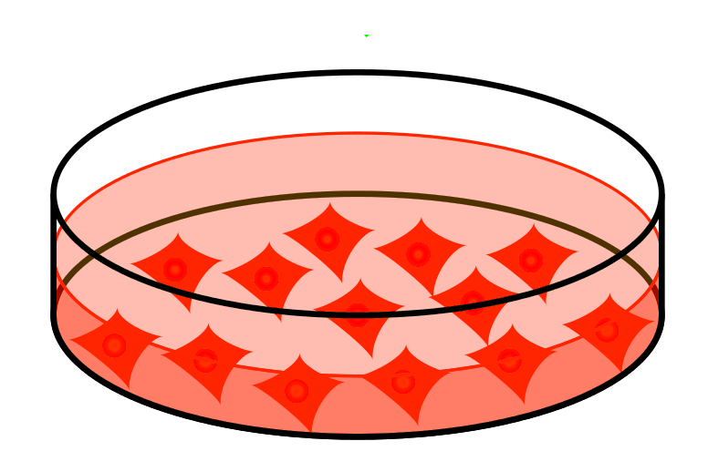

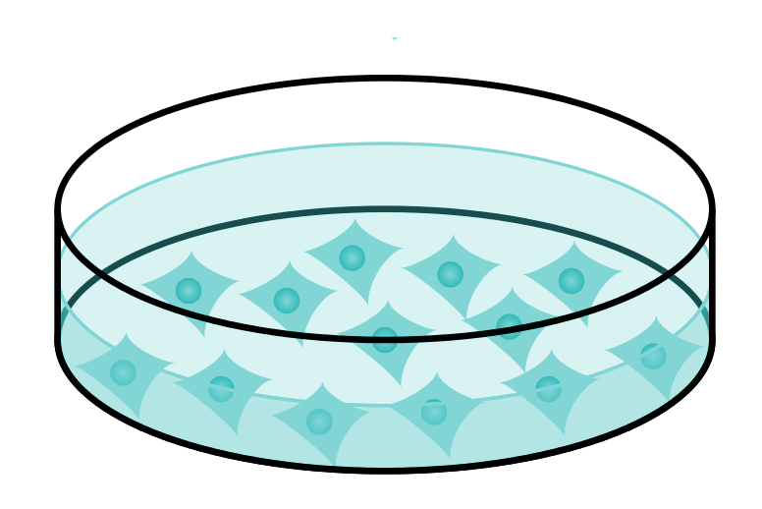
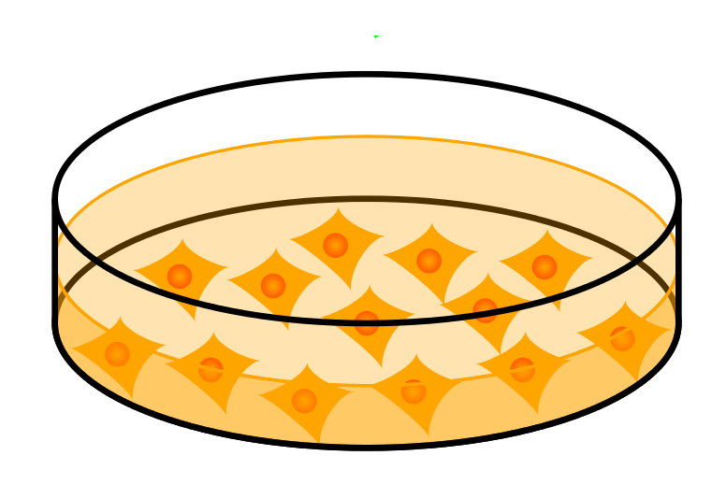
Our dataset
PMID: 24454774
MWCNTs treatment
Time points:
2 hours
12 hours
24 hours
30 µg/mL
3 µg/mL
control
0.3 µg/mL
Output value:
Relative abundance of proteins
(significant p<0.05)

Slide 5
Workflow
Obtain protein-protein interactions
PSICQUIC-based interaction import client in Cytoscape
Visualize network
Cytoscape
Basic network analysis
Filtering your network based on columns
Cytoscape: Using filters
Integrate quantitative proteomics information in the network
Cytoscape: Load columns
Identify heavily connected sub-networks
Cytoscape: clusterMaker2 app
Analyze meaningful GO annotation
Cytoscape: BiNGO app

Slide 6
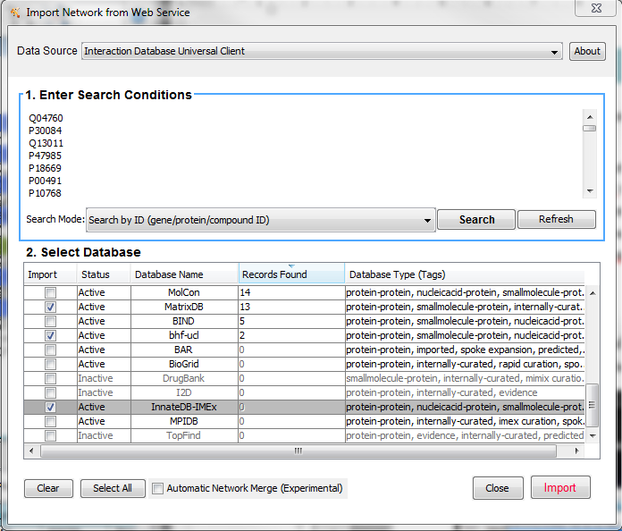
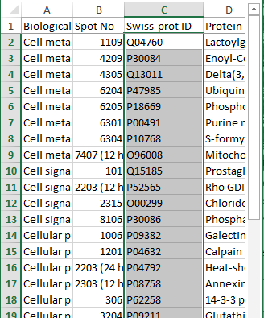
Importing interaction data through PSICQUIC
Cytoscape
File → Import → Network → Public Databases…
copy & paste

Slide 7
Importing interaction data through PSICQUIC
Cytoscape
File → Import → Network → Public Databases…
Select source databases

Slide 8
Importing interaction data through PSICQUIC
IMEx-complying databases
IntAct
MINT
MatrixDB
DIP
I2D-IMEx
UniProt
BHF-UCL
MolCon
InnateDB-IMEx

Slide 9
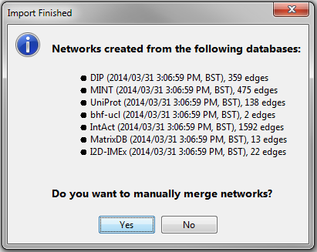
Importing interaction data through PSICQUIC

Slide 10
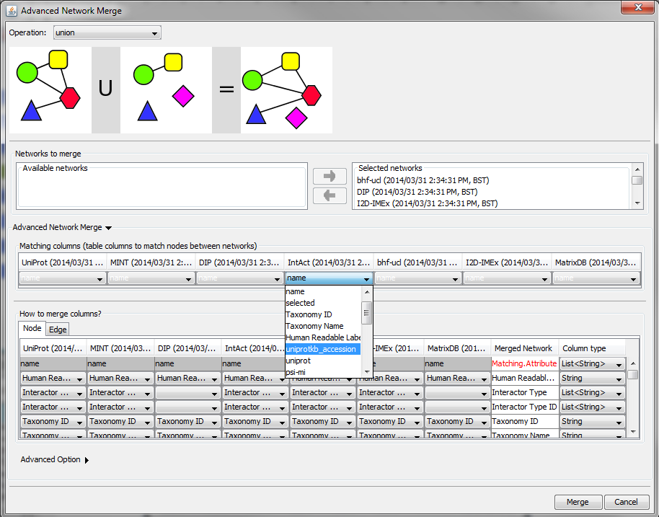
Importing interaction data through PSICQUIC

Slide 11
Workflow
Obtain protein-protein interactions
PSICQUIC-based interaction import client in Cytoscape
Visualize network
Cytoscape
Basic network analysis
Filtering your network based on columns
Cytoscape: Using filters
Integrate quantitative proteomics information in the network
Cytoscape: Load columns
Identify heavily connected sub-networks
Cytoscape: clusterMaker2 app
Analyze meaningful GO annotation
Cytoscape: BiNGO app

Slide 12
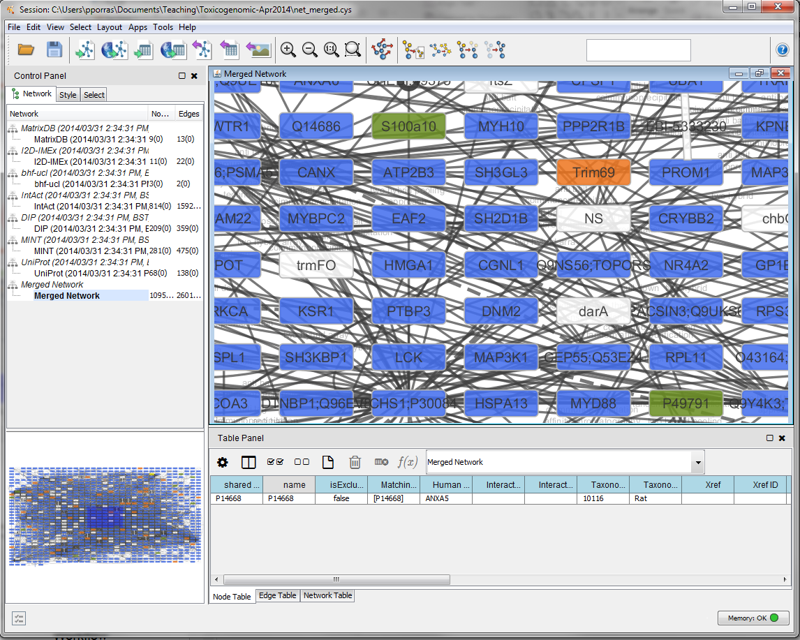
Visualizing the network
1
2

Slide 13
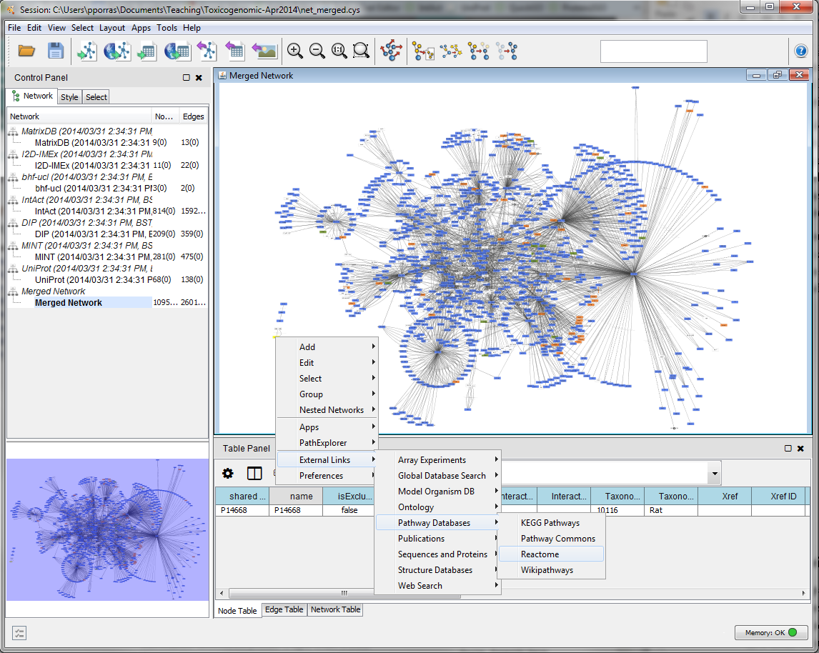
Visualizing the network
Layout → yFiles Layouts → Organic

Slide 14

Find a layout that sorts your network nodes by the number of interactions that each one of them has.

Slide 15
Workflow
Obtain protein-protein interactions
PSICQUIC-based interaction import client in Cytoscape
Visualize network
Cytoscape
Basic network analysis
Filtering your network based on columns
Cytoscape: Using filters
Integrate quantitative proteomics information in the network
Cytoscape: Load columns
Identify heavily connected sub-networks
Cytoscape: clusterMaker2 app
Analyze meaningful GO annotation
Cytoscape: BiNGO app

Slide 16
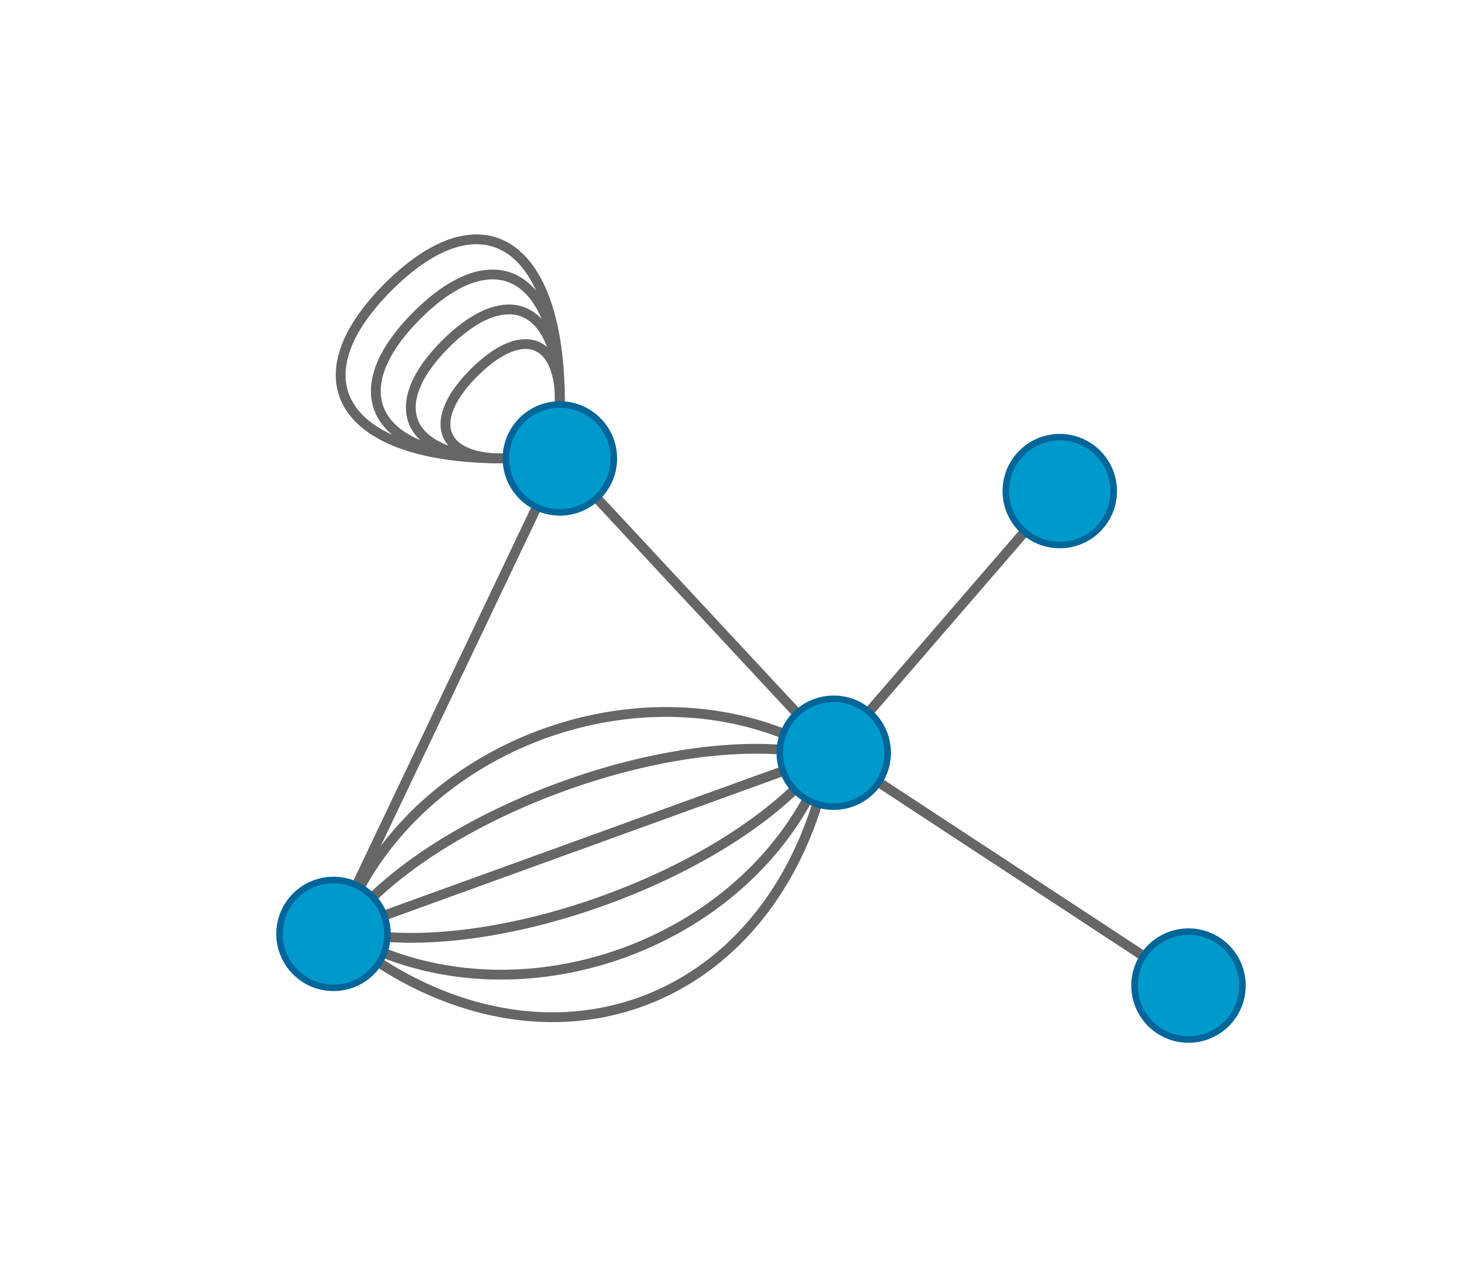
Cytoscape: columns and visual styles
columns hold information about nodes and edges in Cytoscape.
They can be used to create and apply visual styles, allowing for visualization of complex information.
Node columns
Edge columns
Protein name: pp60c-src
Relative expression value: -3.23
Organism: human
Interaction detection method: anti-bait coIP
Confidence score: 0.24
Interaction type: physical association
Database: IntAct

Slide 17
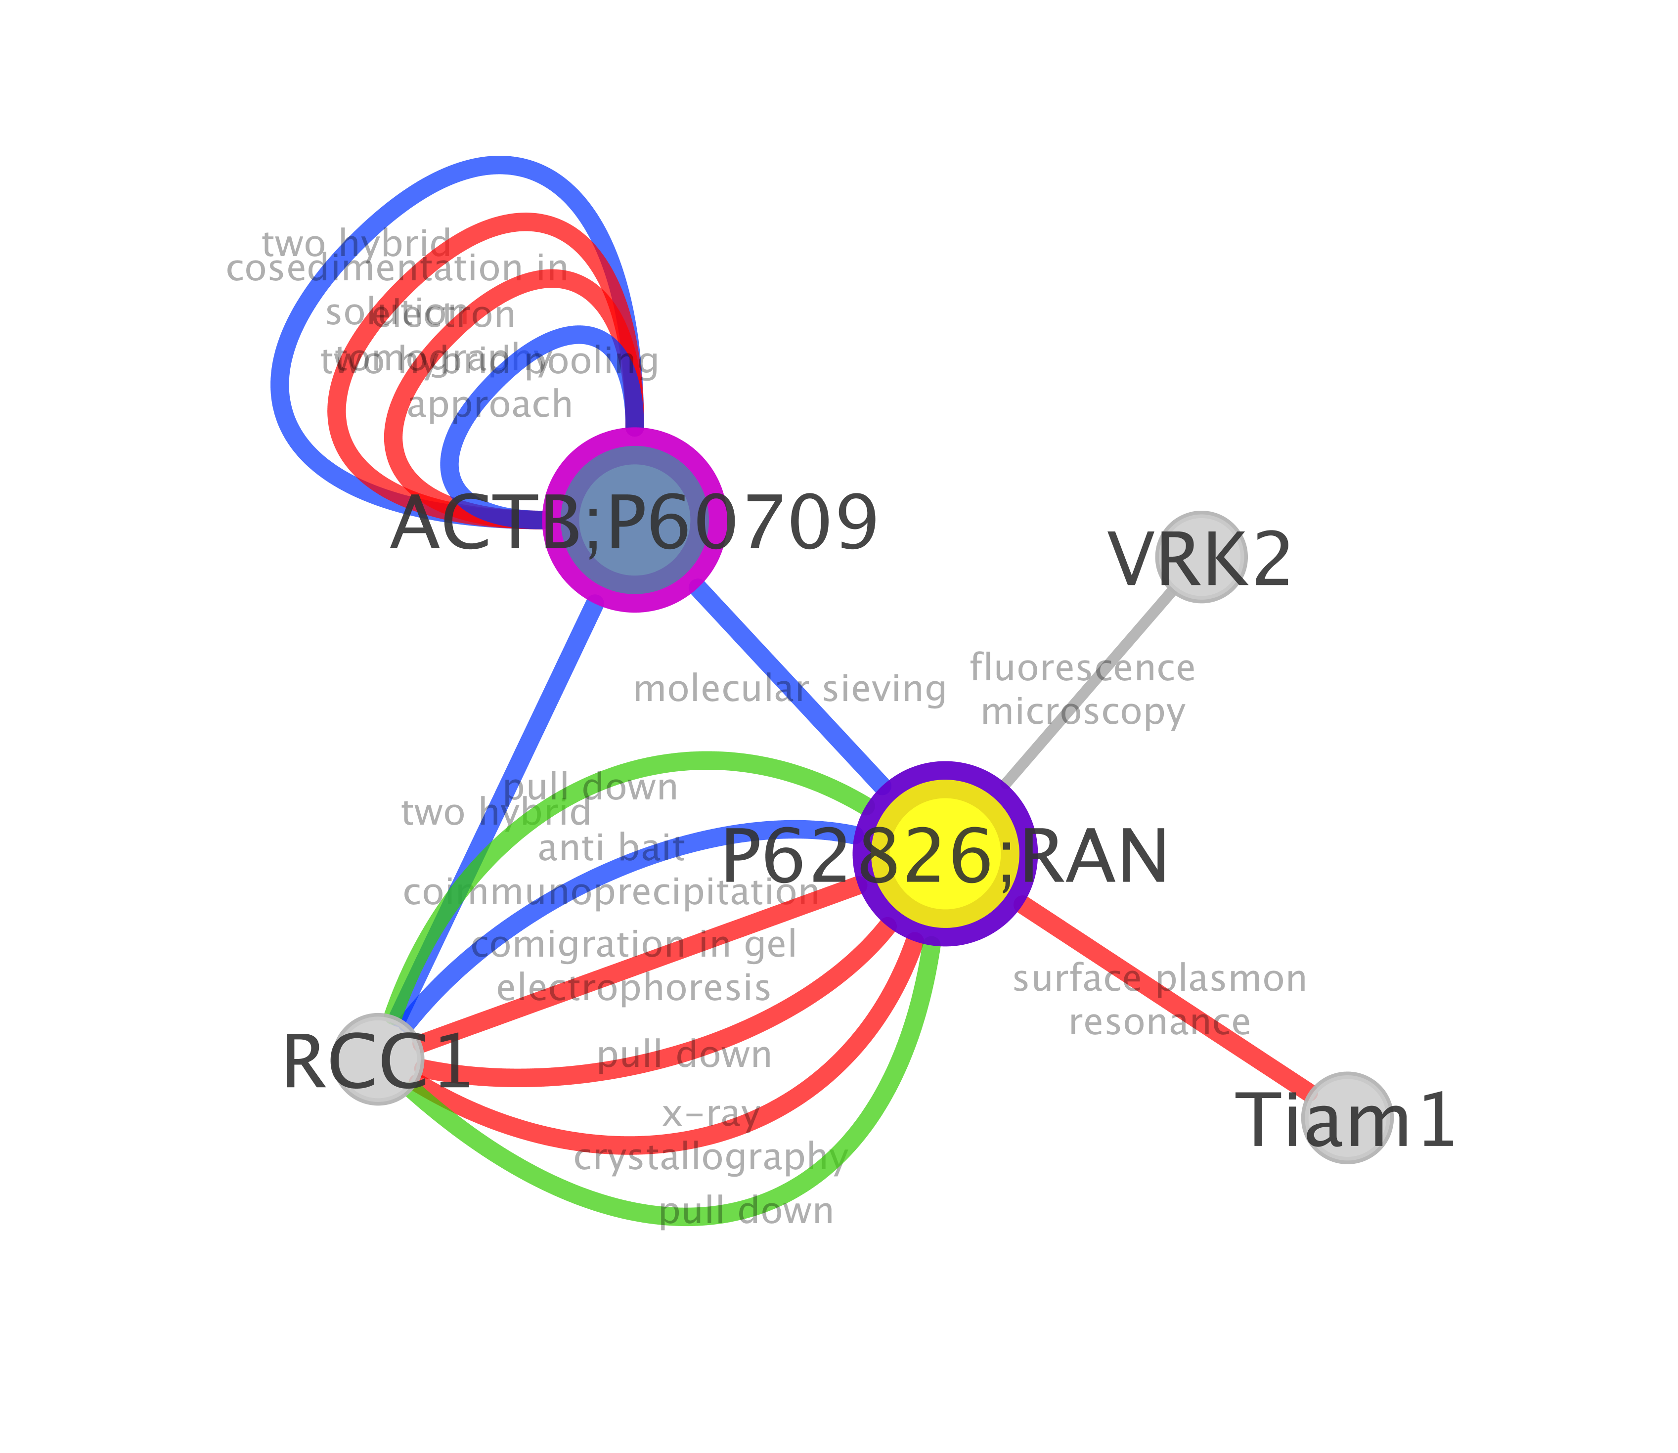
Cytoscape: columns and visual styles
Network after application of a visual style based on its columns
Node columns
Label: Protein name
Colour: Relative expression value
Size: Seed yes/no
Border: Protein family
Edge columns
Label: Interaction detection method
Colour: Interaction type

Slide 18
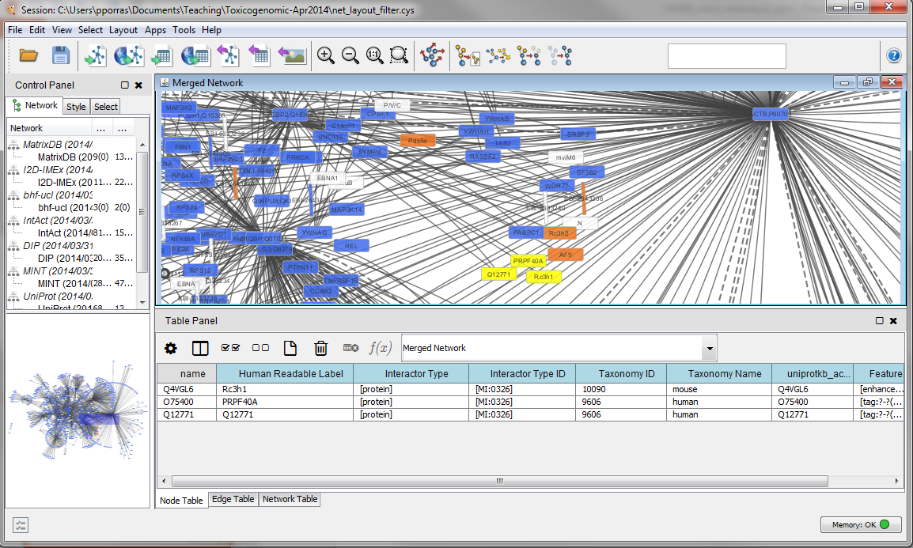
Table panel: nodes

Slide 19
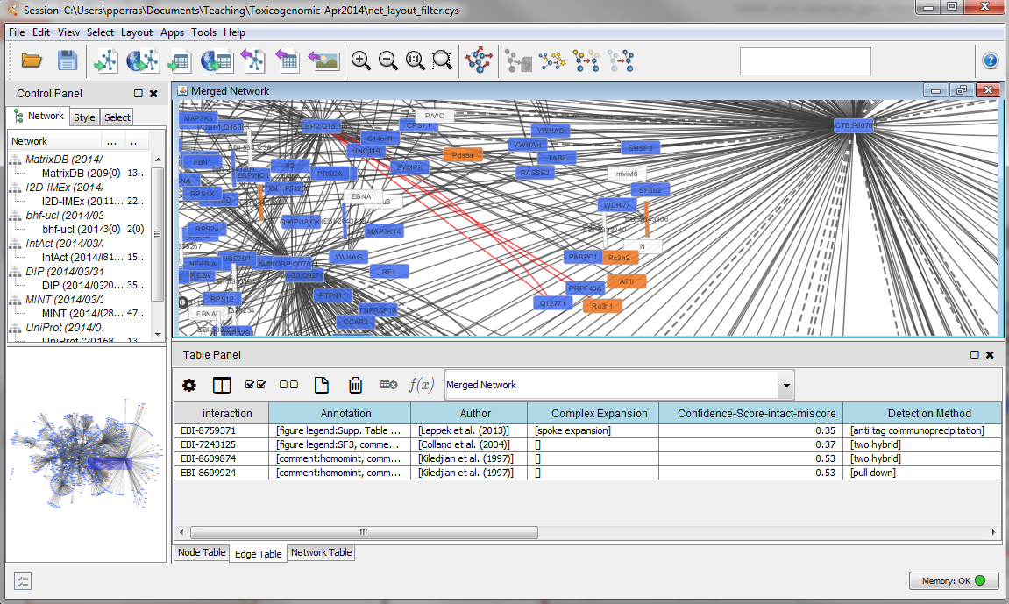
Table panel: edges

Slide 20
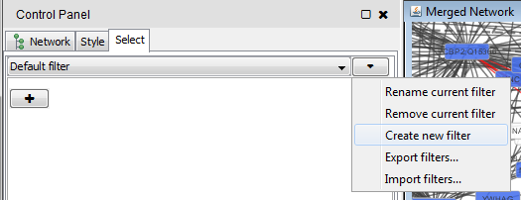
Using selection / filters
In ‘Control Panel’ go to the ‘Select’ tab

Slide 21
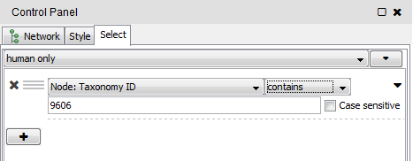
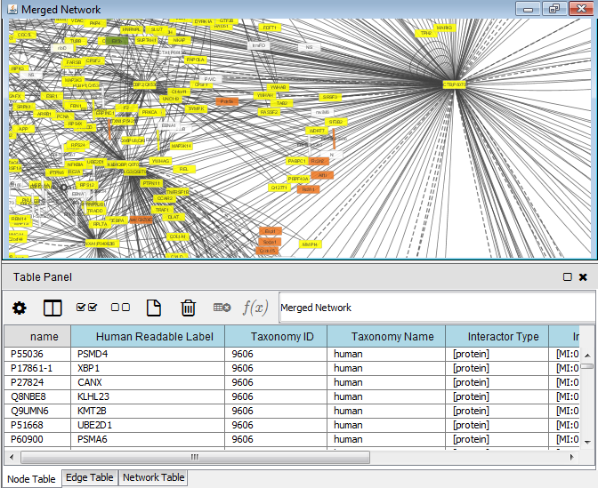
Using selection / filters

Slide 22
Use edge columns to create a network in which all the interactions have been found using the ‘two hybrid’ interaction detection method.

